Slide 1


[Social
Buzz]

Slide 2


Today's agenda
Project recap
Problem
The Analytics team
Process
Insights
Summary

Slide 3

Social buzz is a fast growing technology unicorn that need to adapt quickly to it’s global scale. Accenture has begun a 3 month POC focusing on these task:
Project Recap
An audit of social Buzz’s big data practice
Recommendations for a successful IPO
Analysis to find Social Buzz’s top 5 most popular categories of content.

Slide 4

njhj
Problem
Over 100000 post per day
36,500,000 pieces of content per year!
Analysis to find Social Buzz’s top 5 categories with the largest popularity.

Slide 5




Radhika Saini Data Analyst
s
The Analytics team
Marcus Rompton Chief Senior Principle
Andrew Fleming Chief Technical Architect

Slide 6
Which problem needs to be solved
Process
1
Understand the problem
2
Gather dataset
3
Clean and Preprocess the data
Solve the problem and Visualize the insights
4
5
Present insights

Slide 7

Insights
Highest post MAY
Top category Animal
Unique categories 16

Slide 8
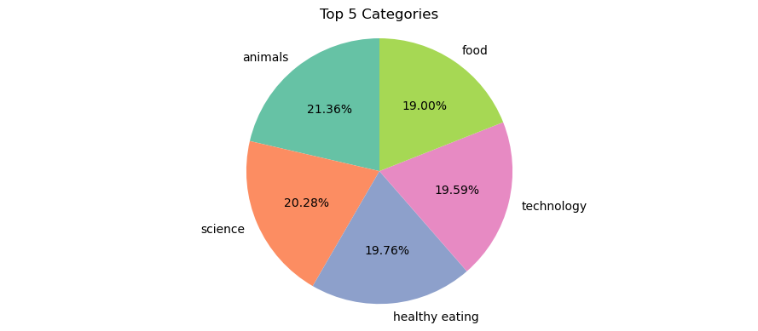
the Top 5 performing categories
Category animals 74965 science 71168 healthy eating 69339 technology 68738 food 66676

Slide 9
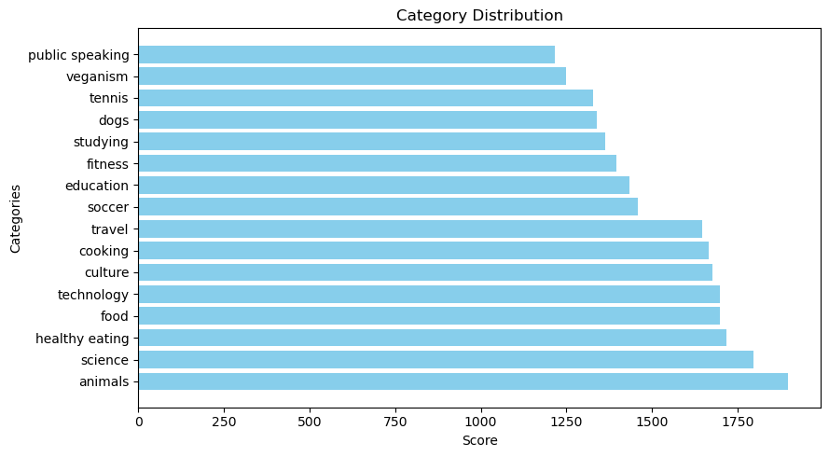
How many unique categories are there?

Slide 10
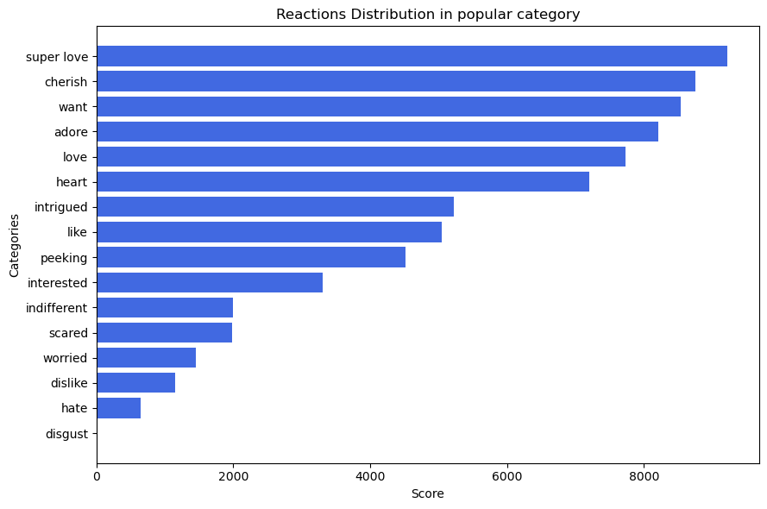
How many reactions are there to the most popular category?

Slide 11
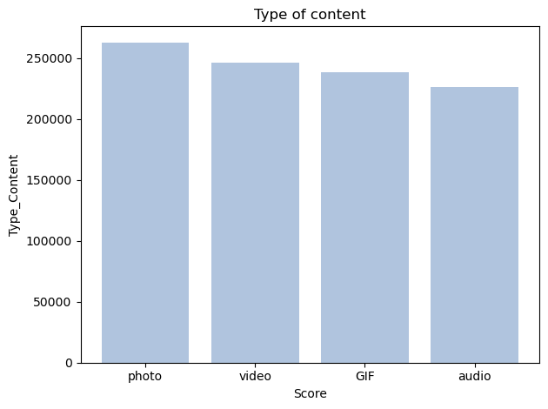
what type of content doing great?
 | Score
Type_Content
photo | 262838
video | 246463
GIF | 238217
audio | 226127

Slide 12
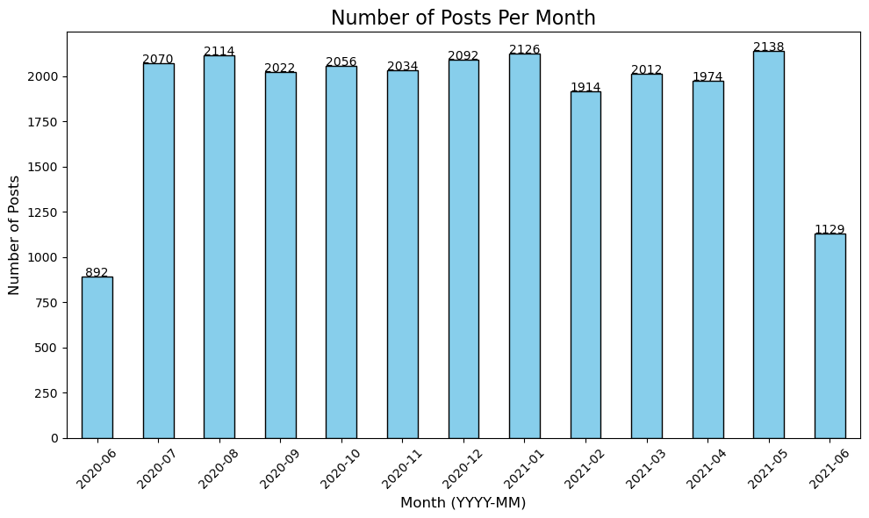
What was the month with the most posts?
the month with the most post is May, with 2138 post.

Slide 13

There are total 16 unique categories . Animal, Science, healthy eating, technologies , food are top five categories.
4 type of content- Photos, videos, Gif, and Audio. Out of which people prefer photos and videos.
May month has the highest number of posts. Conclusion
More content should be created related to these top 5 categories for more engagement.
As we can see, Healthy eating and food are also in the top 5. The company should run campaigns related to healthy eating.
Company should plan marketing and content strategies in May, January, and August, as these months have the highest number of posts.
Summary

Slide 14
Thank you!
ANY QUESTIONS?

